Slide 1

Visual Python
BY:
ADNAN AMIN, Ph.D.
Faculty Member
School of Computing and Info. Tech.
Institute of Management Sciences, Peshawar.
Online Portfolio: www.geoamins.com

Slide 2
Outlines

Slide 3



Visual Python
Visual Python is a GUI-based Python code generator for data science.
Visual Python is an open-source project started for students who struggle with coding during Python classes for data science
Extension available for:
Notebook
source: https://databricks.com/

Slide 4
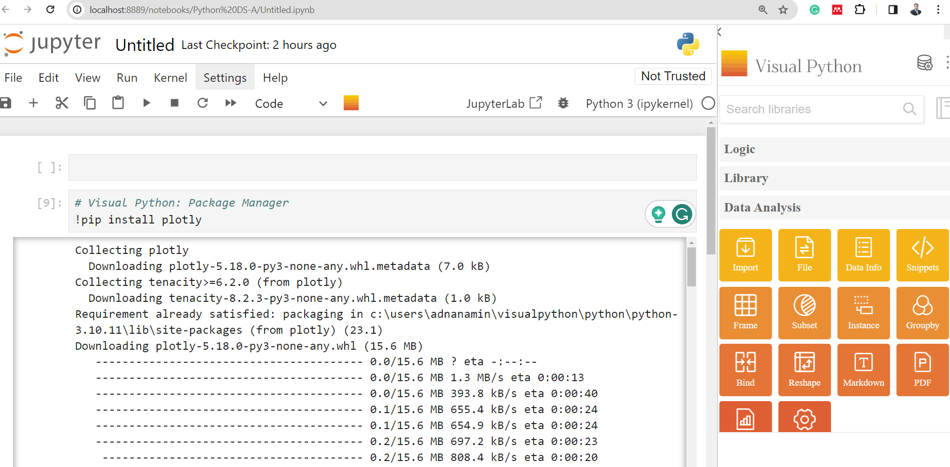
Visual Python Interface

Slide 5
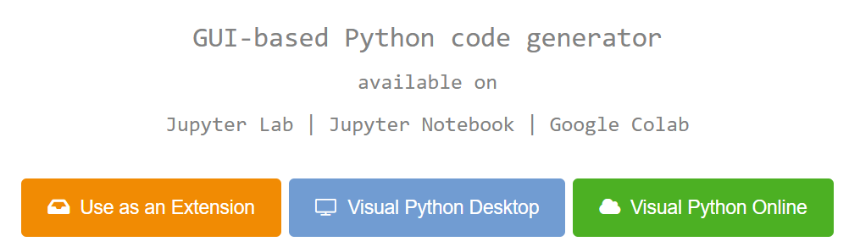
Installation of Visual Python
Visit: https://visualpython.ai/

Slide 6
Option # 1. Use as an extension
Pip Installation for Jupyter Lab & Package Activation
pip install jupyterlab-visualpython
Click orange square button on the right side of the Jupyter Lab side bar.
Pip Installation for Jupyter Notebook & Package Activation
pip install visualpython
visualpy install
Click orange square button on the right side of the Jupyter Notebook menu.
Version Check
visualpy version
visualpy upgrade
visualpy uninstall
visualpy help
…Next slide for screenshot→

Slide 7
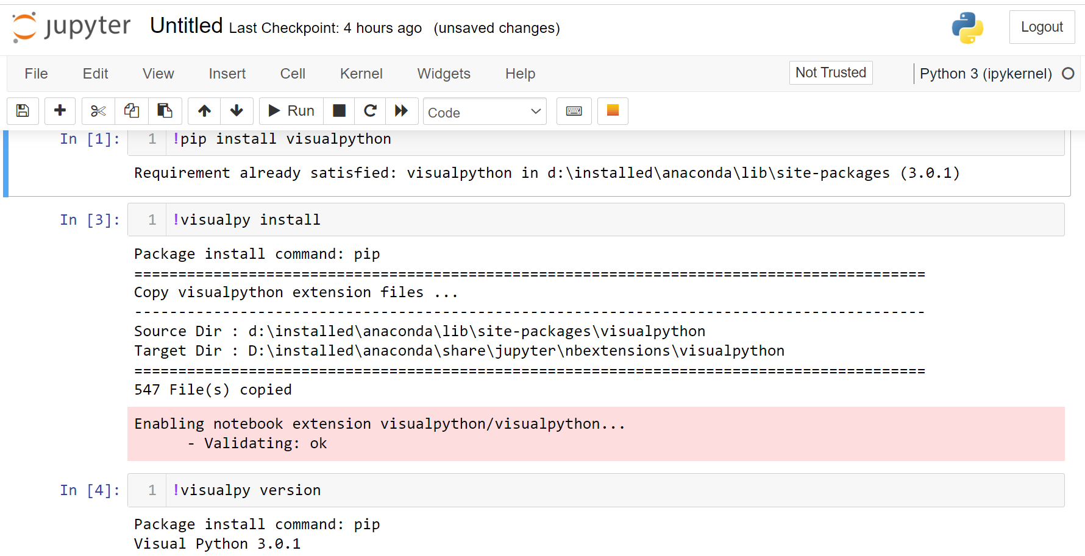

Slide 8
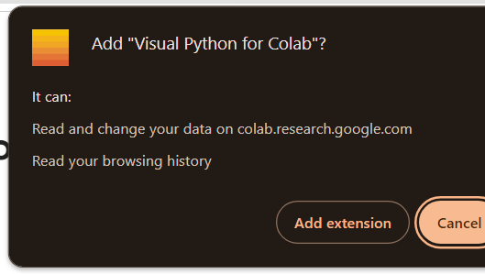
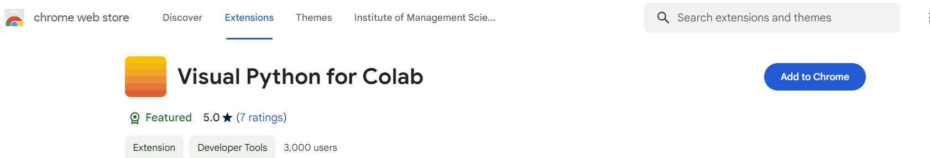
Chrome extension Installation for Google Colab
1. Install package from chrome web store
https://chromewebstore.google.com/detail/visual-python-for-colab/ccmkpknjfagaldcgidgcipbpdipfopob
2. Login into your Google Colab Account
https://colab.research.google.com/

Slide 9
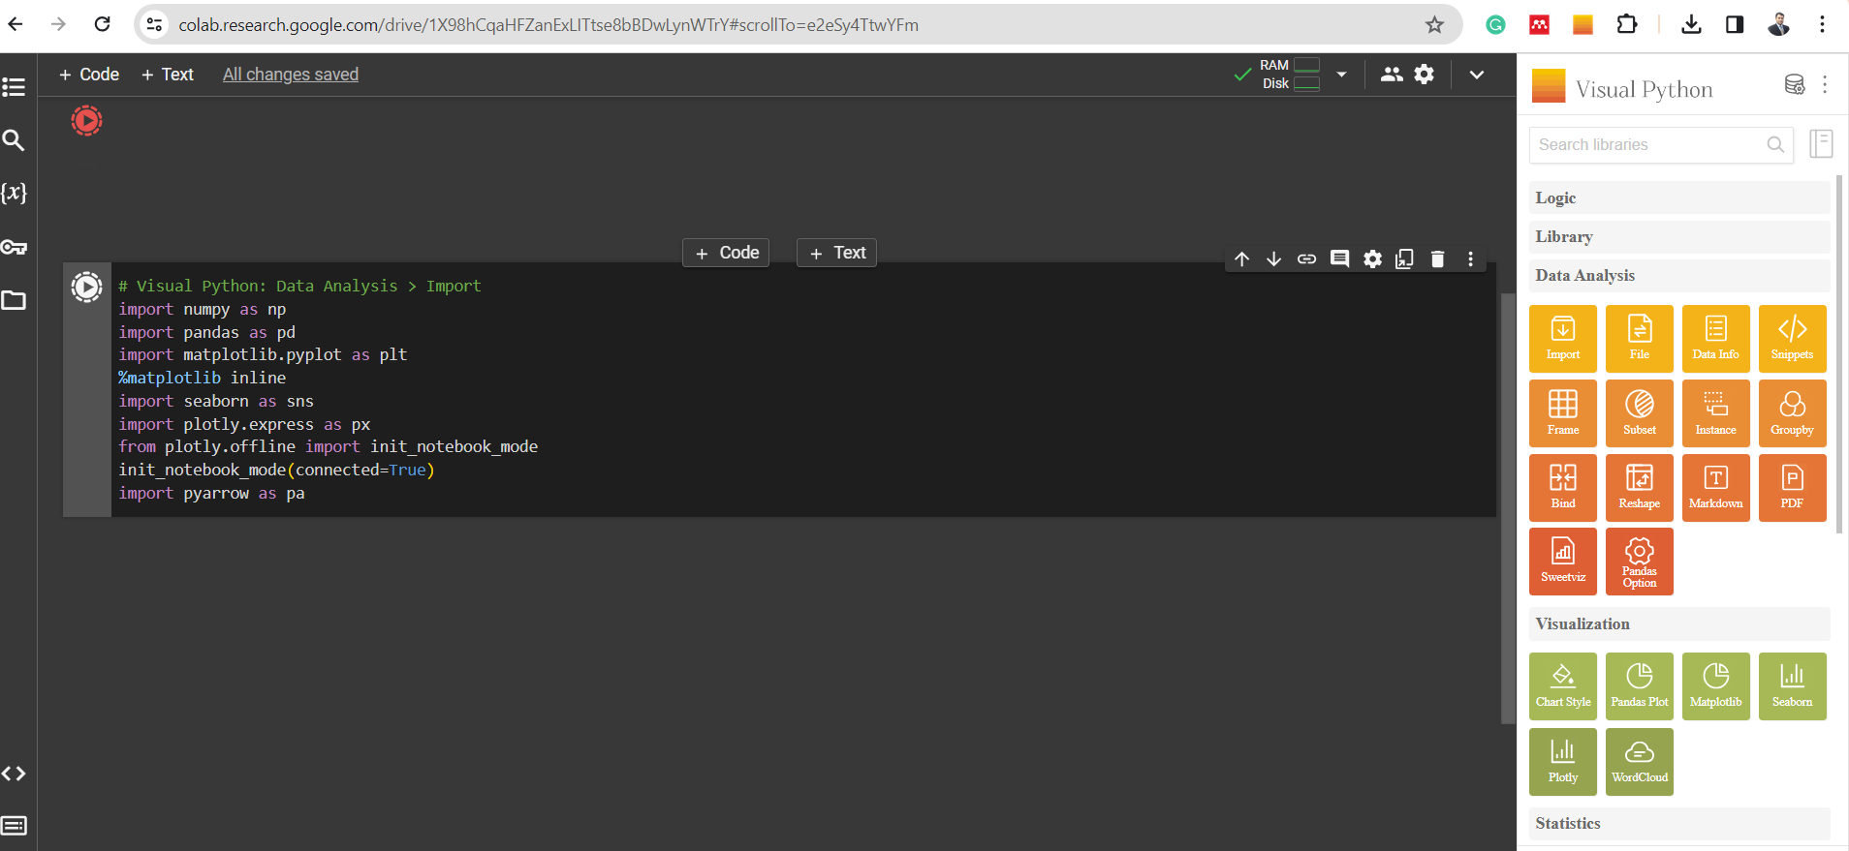
Google Colab and Visual Python

Slide 10

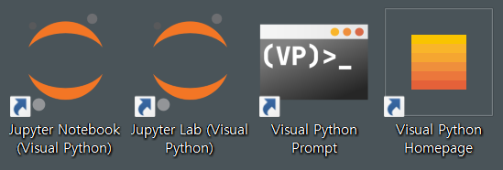
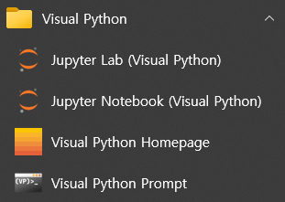
Option# 2: Visual Python Desktop
Independent Python Environment Setup:
Download the Visual Python Desktop installer.
Start menu or on Desktop to execute:
System Requirements:
Operating System: Windows 10 or later (macOS and Linux support coming soon)
Minimum 4GB RAM, recommended 8GB RAM or higher
Minimum 10GB of disk space
Notes:
Visual Python Desktop is an installation program that empowers users to easily set up data analysis environment based on python and generate Python code using Visual Python.
It simplifies the process of configuring an independent Python environment, installing essential packages, and setting up a Jupyter environment, allowing users to focus on data analysis using python.

Slide 11
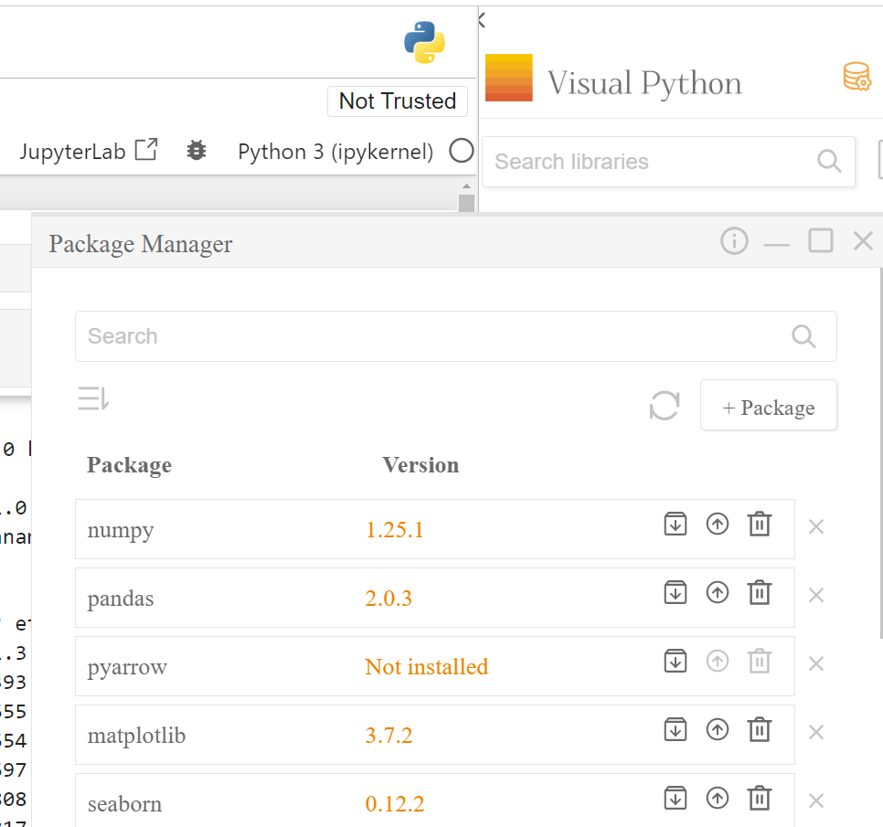
To import packages/libraries
Click on the Import app from the menu.
Select libraries you need.
Click Run button to generate code.

Slide 12
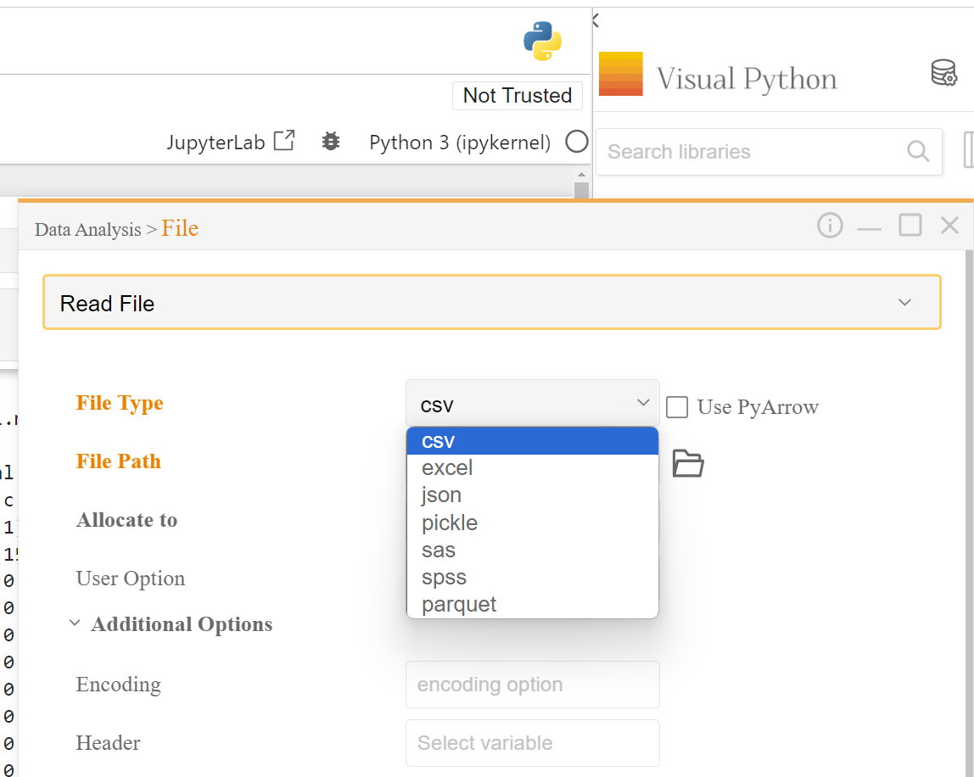
To read data from a file
Click on the File app, to read data files.
Identify the data type:
CSV, Excel, JSON, Pickle
Click on the folder icon to open the file explorer.
Use additional options if necessary.
Click Run

